Slide 1
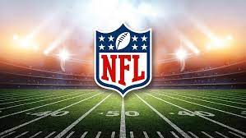
Super Bowl Predictions
By: Carl Bent, Deron Porter, Chin Hsu, Otha Richardson ll

Slide 2
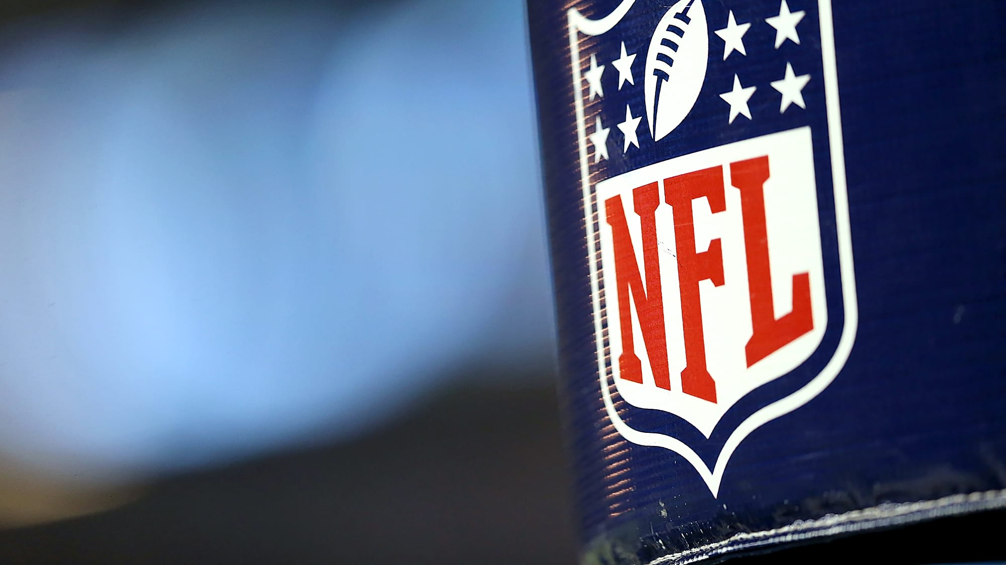
Executive Summary
Around the world people use statistics to predict which fantasy football team to invest in. We have created an algorithm that will eliminate your time needed to research NFL statistics. You can actually sit back and enjoy the game, without worrying about the numbers.

Slide 3
Concept
Description:
Creation of a machine learning algorithm that will help predict which team will win the Super Bowl.
Motivation for development?
Millions of NFL fans and investors use statistics to be able to find out which team to bet on.
User story
A user will be able to look at our algorithm, and be able to predict which team they want to invest in.

Slide 4
Data Techniques
We are able to determine this based off of
Number of wins per team
Net Points
Previous SuperBowl Wins
Reasoning for data selection
Utilizing the number of wins as a variable benefited us because adding the amount of yards ran, passing, or even touch downs contribute to the number of wins a team has.
Collection, exploration and cleaning process.

Slide 5
Approach
Technologies used
Languages: Python
Libraries: Pandas, Sklearn, processing, standard scaler, HvPlot.
Platform: Amazon Web Services, Jupyter lab, Sagemaker,
Breakdown of tasks and roles
Otha Richardson ll- Data Research, Data Cleaning, Coding, Analysis
Chin Hsu- Data Research, Data Cleaning, Coding
Deron Porter- Data Research
Carl Bent- Data Research, Powerpoint Presentation
Challenges
Using one data point or multiple
We chose the statistical methodology of wins and losses as the variable that due
Successes

Slide 6
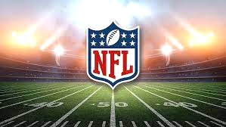
Project #2 Demo

Slide 7
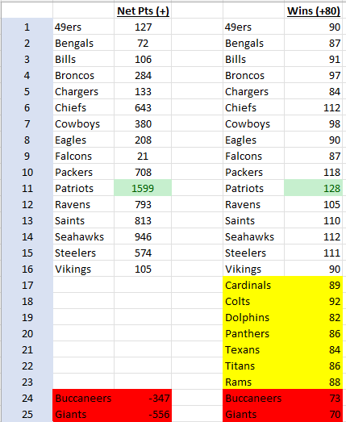
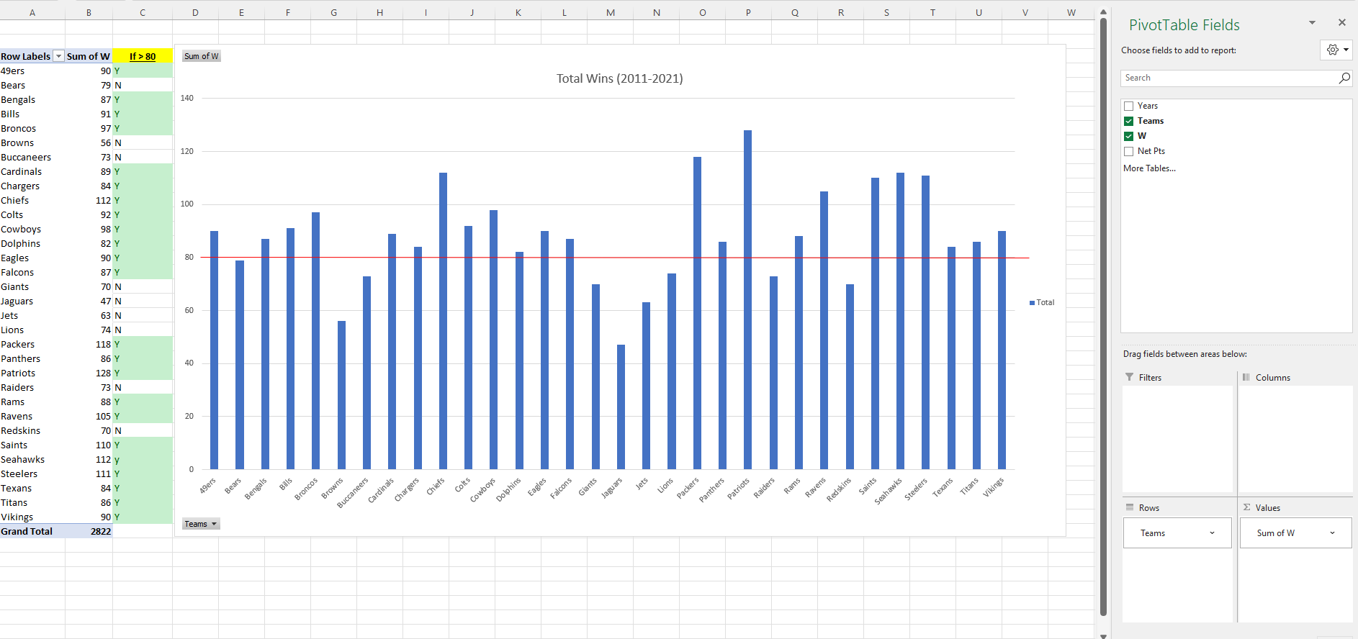
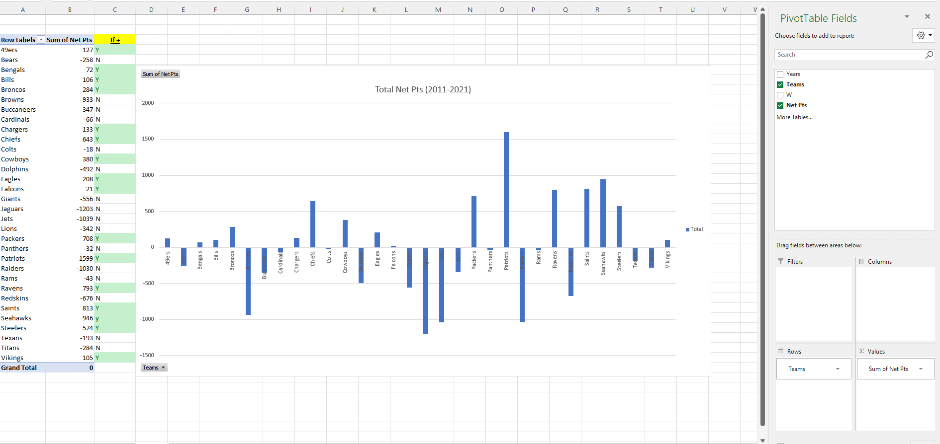
Preliminary Analysis - MS Excel (2011-2021)
‘Net Points’ is the biggest predictor for wins.

Slide 8
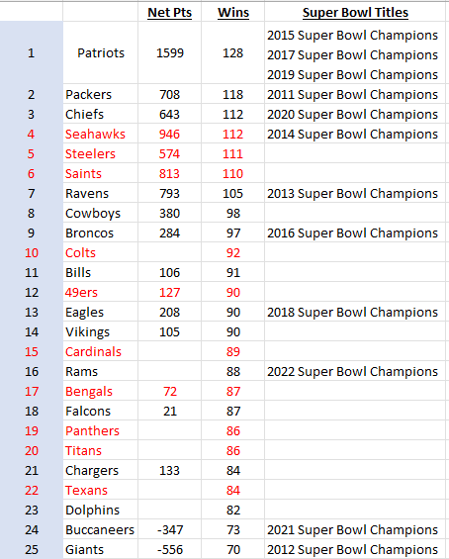
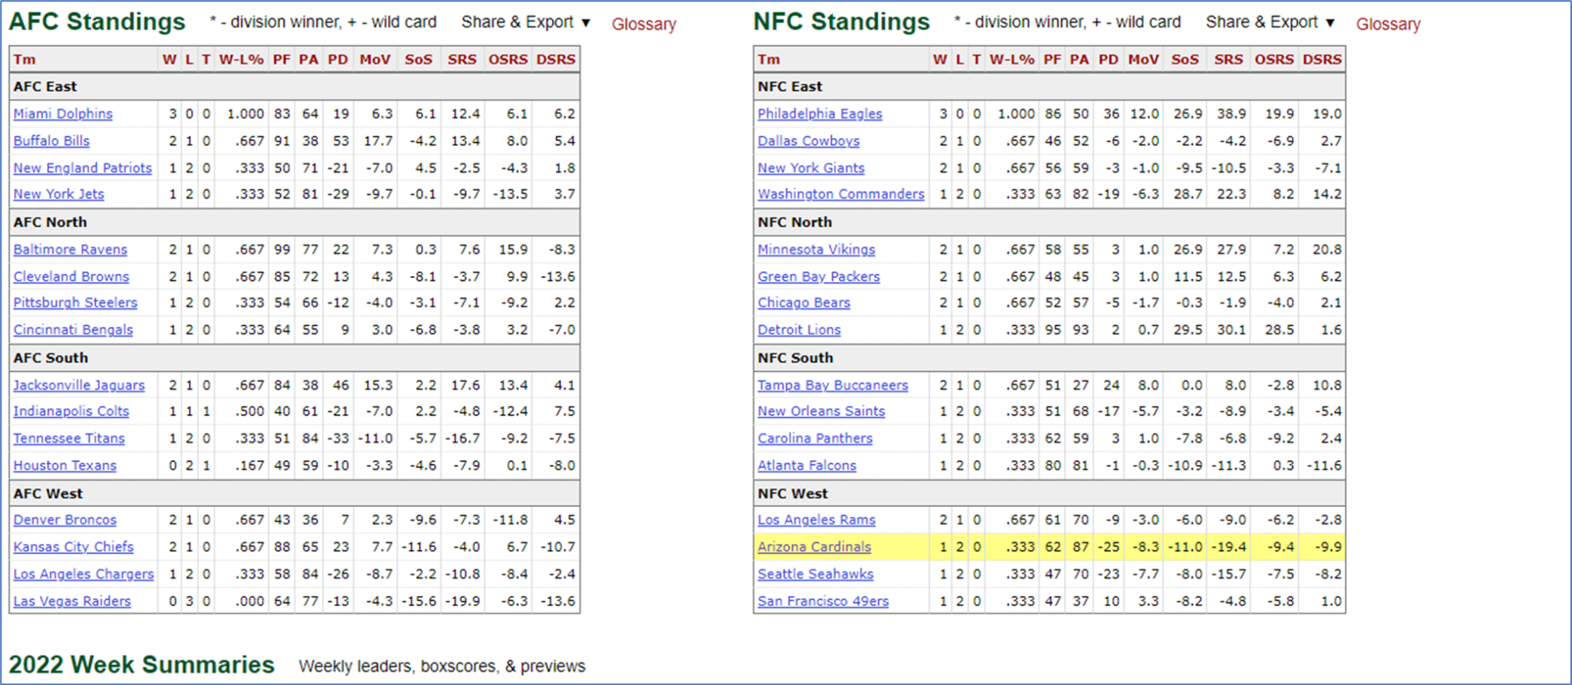
Preliminary Analysis - Current Data & SuperBowl History
** Added SuperBowl History (0 or 1), current standings considerations, and qualitative information (ie Tom Brady transfer to Buccaneers…Russell Wilson to Broncos…Rams 2022 SuperBowl Winners)

Slide 9
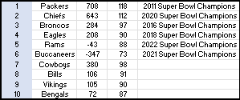
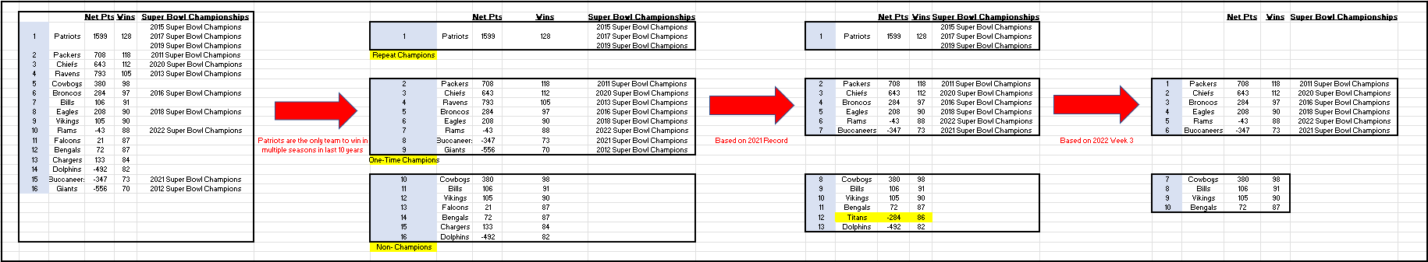
Preliminary Analysis - Decision Tree
** Removed New England Patriots as the outlier. They are the ONLY NFL Team with multiple wins in the last decade.

Slide 10
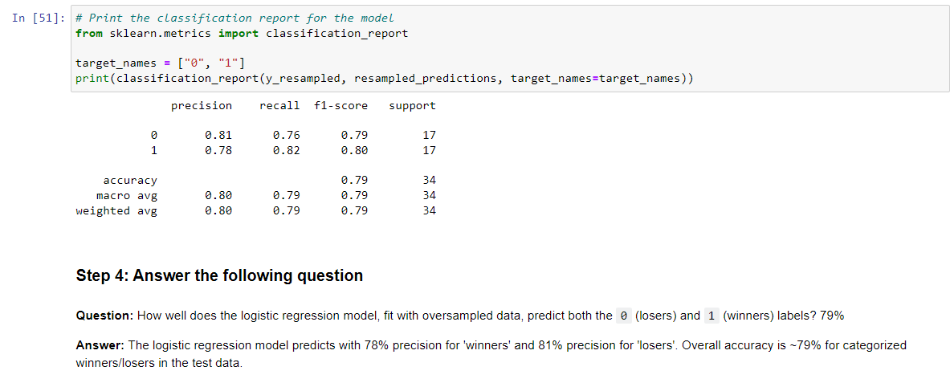
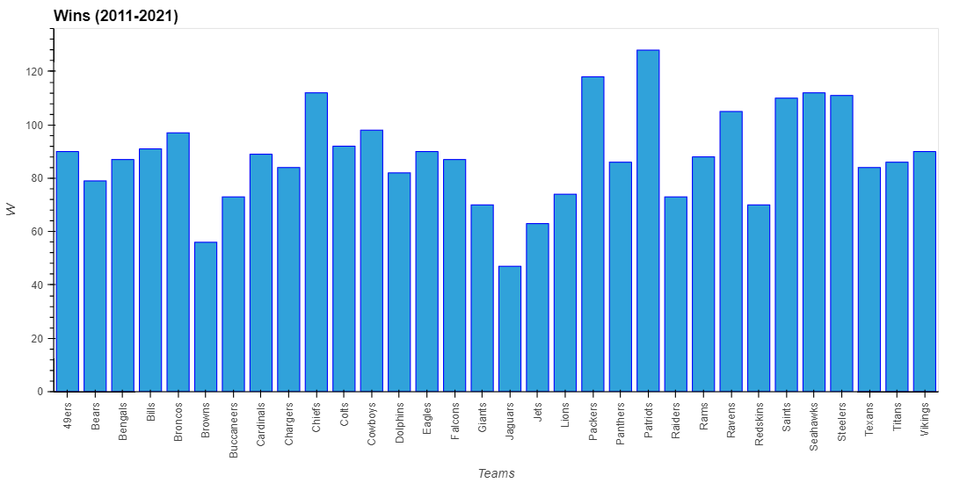
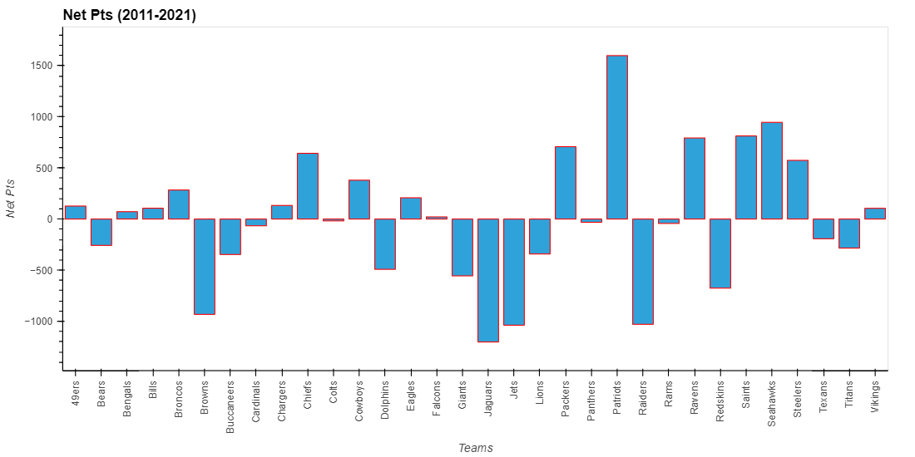
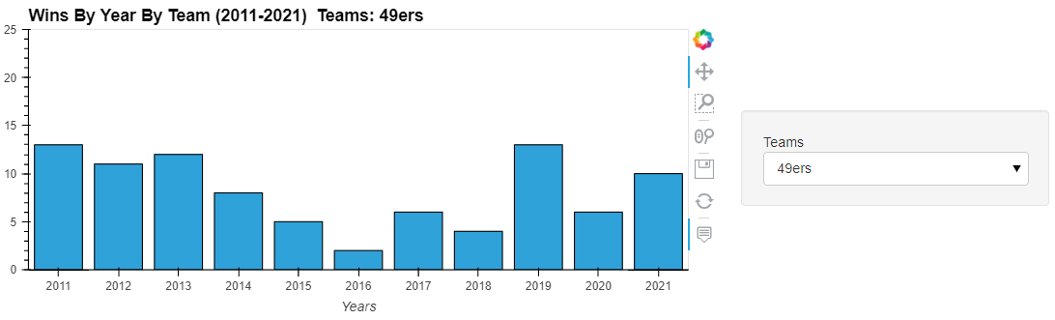
Data - Logistic Regression

Slide 11
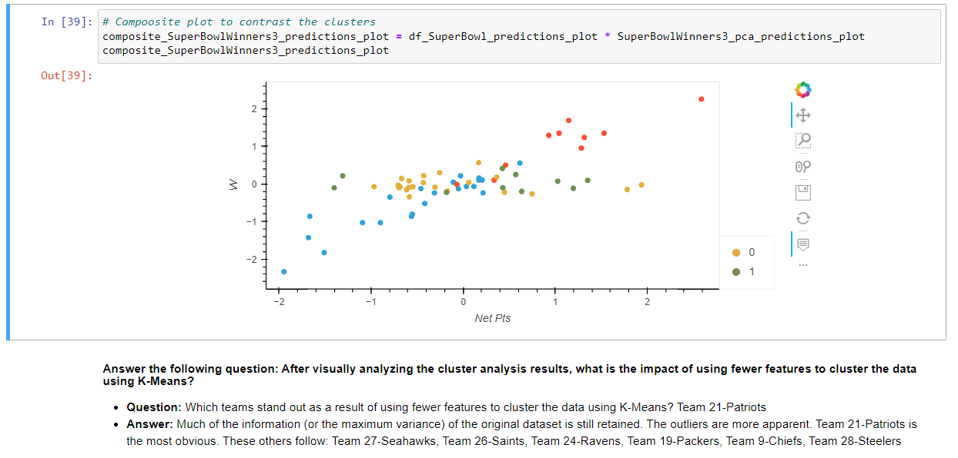
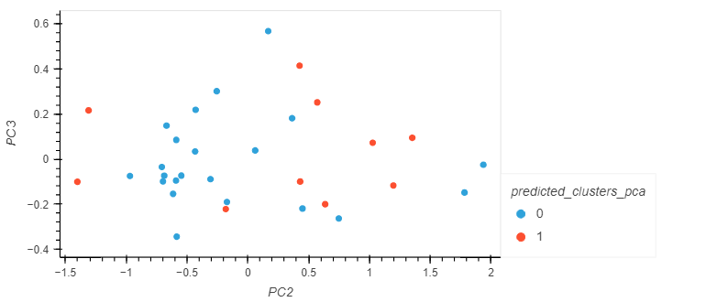
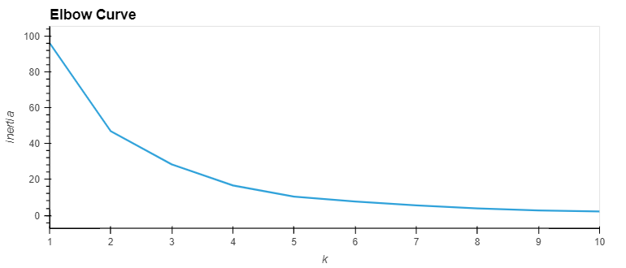
Data Continued- Clustering

Slide 12
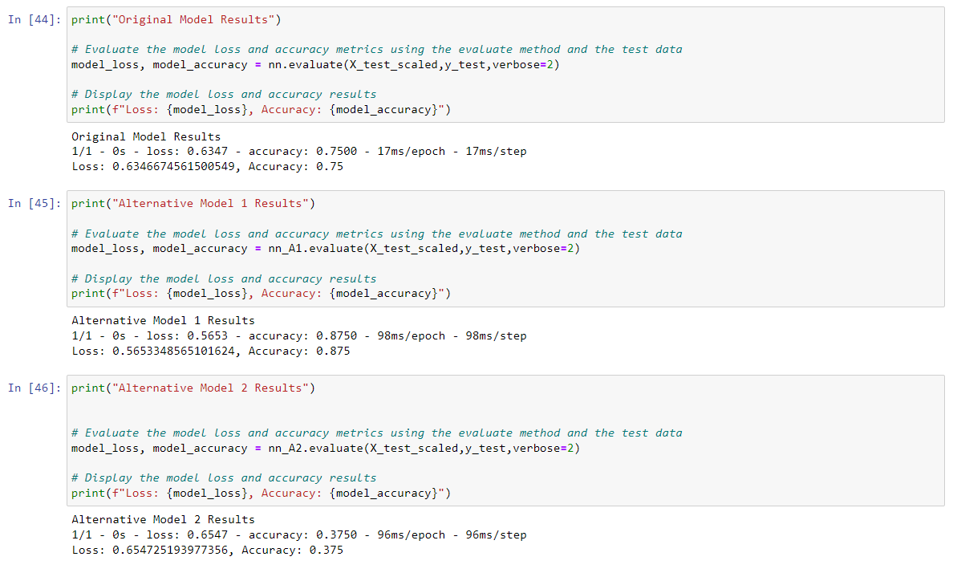
Data Continued- Deep Learning

Slide 13
Next Steps
Additional questions that surfaced.
Additional topics to research.
Plan for future development.

Slide 14
Links
Work Sited
Deployed application.
Github Repository
National Football League- (NFL)
https://www.nfl.com/stats/team-stats/
https://www.nfl.com/standings/

